Slide 1
Deep Learning Practice Lab 02
Hyemi Jang & Jisoo Mok

Slide 2
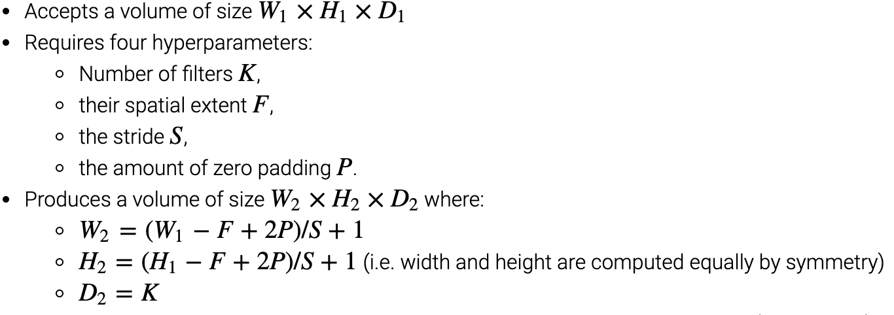
Convolutional Layer
Source: cs231.github.io/convolutional-networks/

Slide 3
Pooling Layer
Dimensionality Reduction
Max pooling: noise reduction
Source: https://towardsdatascience.com/a-comprehensive-guide-to-convolutional-neural-networks-the-eli5-way-3bd2b1164a53

Slide 4
Fully Connected (FC) Layer
Source: https://towardsdatascience.com/a-comprehensive-guide-to-convolutional-neural-networks-the-eli5-way-3bd2b1164a53

Slide 5
Activation Functions
Introduces additional non-linearities to deep neural networks.
Source: cs231.github.io/convolutional-networks/

Slide 6
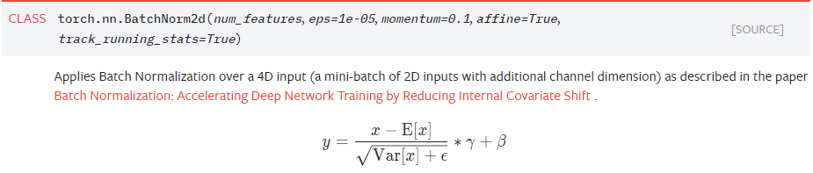
Batch Normalization
Internal covariate shift: changes in the distribution of the inputs of each layer
Reduces internal covariate shift by normalizing layer inputs.
First introduced in: https://arxiv.org/abs/1502.03167

Slide 7
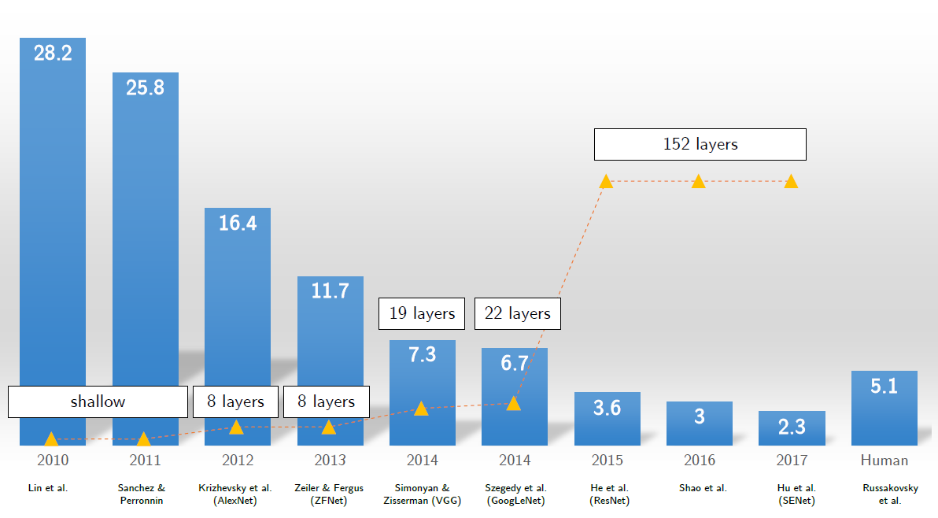
Famous CNN Networks
Revolution of Depth
Source: Professor Sungroh Yoon’s Ppt Slides
Notes:
교수님 자료에서 reference 찾아서 달기

Slide 8
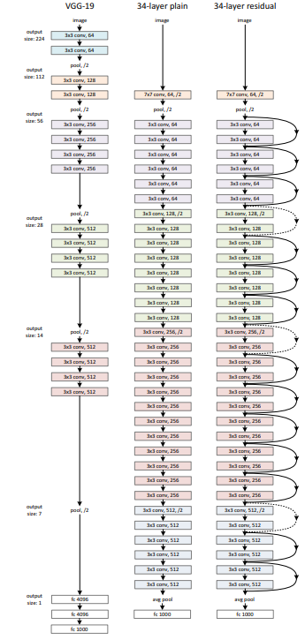
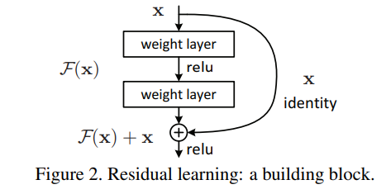
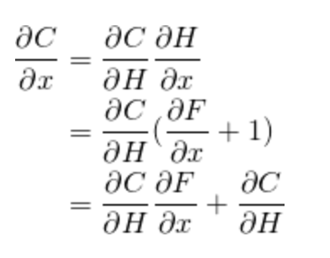
ResNet – Residual Block
Why use residual blocks?
Gradient flow!
Output H(x) = F(x) + x
He, Kaiming, et al. "Deep residual learning for image recognition." Proceedings of the IEEE conference on computer vision and pattern recognition. 2016.
Notes:
Resnet paper reference

Slide 9
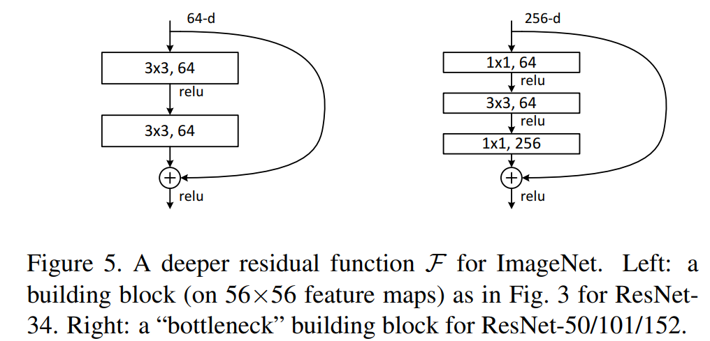
2 Building Blocks of ResNet
Bottleneck layers: reduce the number of computations
Used for deeper ResNet models (i.e. ResNet-50/101/152)
Time permitting, we will try to design both.
He, Kaiming, et al. "Deep residual learning for image recognition." Proceedings of the IEEE conference on computer vision and pattern recognition. 2016.

Slide 10
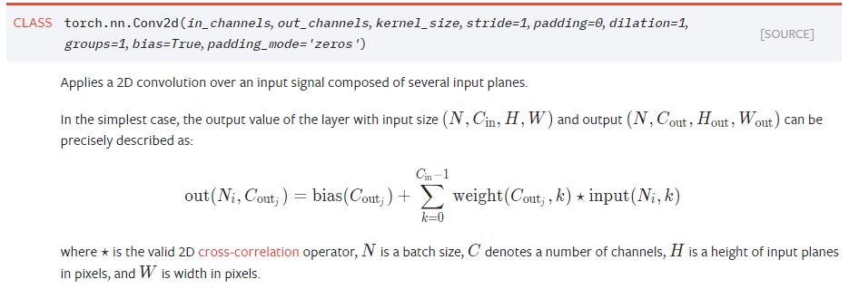
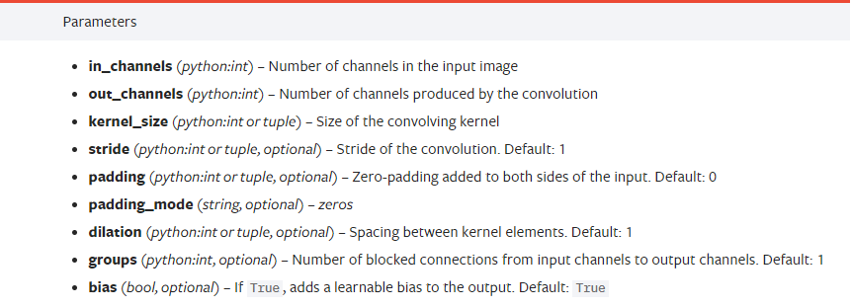

ResNet – Basic Block
torch.nn.Conv2d
A basic 2D convolution operator
Source: https://pytorch.org/tutorials/

Slide 11
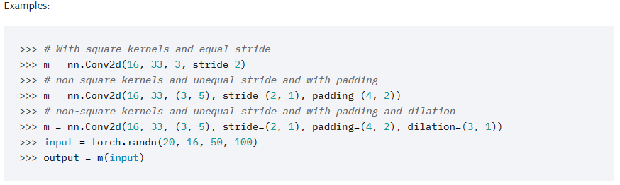
ResNet – Basic Block
torch.nn.Conv2d
Example
Source: https://pytorch.org/tutorials/

Slide 12
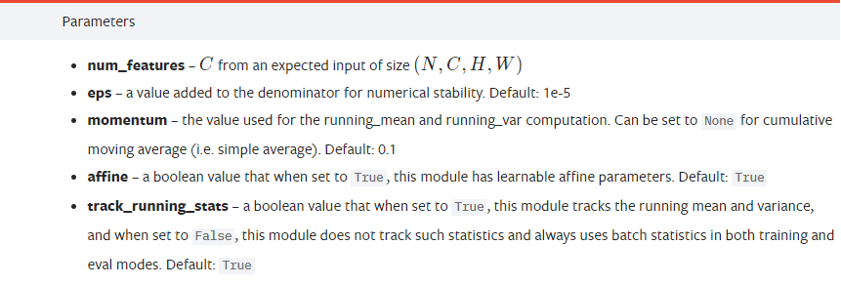
ResNet – Basic Block
torch.nn.BatchNorm2d
Apply a batch normalization layer to accelerate training
Source: https://pytorch.org/tutorials/

Slide 13
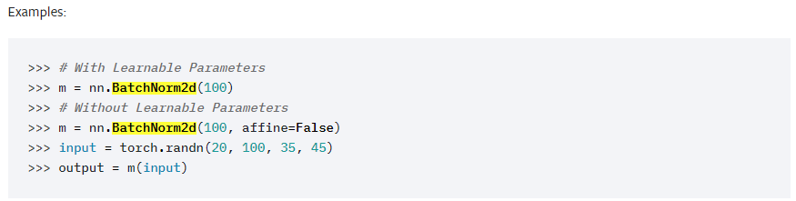
ResNet – Basic Block
torch.nn.BatchNorm2d
Example
Training vs. Inference
Source: https://pytorch.org/tutorials/,
& PyTorch Official Documentation
Notes:
Train vs eval mode difference
-> eval mode: test 할때 쓰는거다
Why batchnorm만 이렇게 다른지?

Slide 14
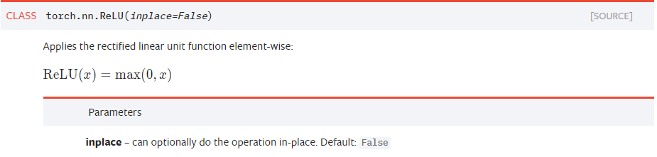
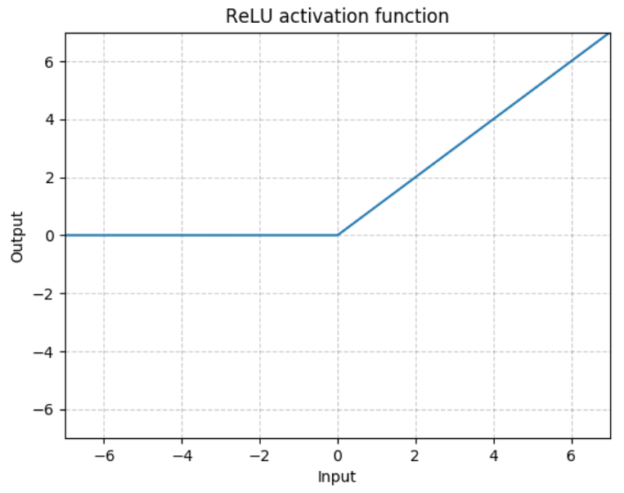
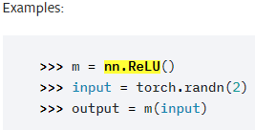
ResNet – Basic Block
torch.nn.ReLU
Activation function
Source: https://pytorch.org/tutorials/
Notes:
Example 합치기

Slide 15
ResNet – Basic Block
What if these two feature maps are of different sizes?
When creating this shortcut connection, we need to apply 1x1 conv with stride of 2!
1x1 conv: matches # of channels
stride 2: matches the width and the height
Notes:
코드 이그젬플 잘 안보임
이유가 전달이 안됨 -> 순서 바꾸기

Slide 16
ResNet – Bottleneck Block
Basic block + 1x1 convolution (aka pointwise convolution)
He, Kaiming, et al. "Deep residual learning for image recognition." Proceedings of the IEEE conference on computer vision and pattern recognition. 2016.
Notes:
코드가 잘 보이도록

Slide 17
Training the Model
Call model.train() function.
Load data using DataLoader.
Flush the previous gradient.
Calculate the loss using a loss function of your choice.
Backpropogate using the calculated loss.
Track the accuracy of the model after each epoch.

Slide 18
Testing the Model
Call model.eval() function.
Some layers (i.e. BatchNorm, Dropout) behave differently
Load data using DataLoader.
with torch.no_grad():
Accelerate computations & Reduce memory usage
Calculate the loss using a loss function of your choice.
Calculate the test accuracy of the model.
Notes:
볼드부분 설명 (빨라짐 or less memory, 확인필요)

Slide 19
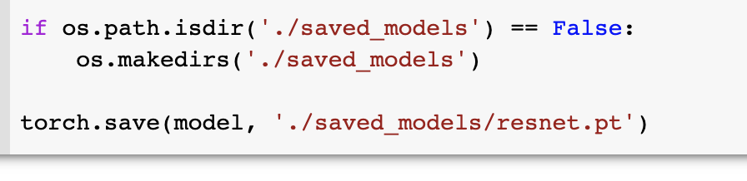
실습 #2
ResNet Implementation
Conv layer design: kernel size = 3x3, stride = 1, padding = 1
No bias on convolutional layers
Basic block
Bottleneck block
Train and Test function Implementation
Train: model.train() mode
Test: model.eval() mode
Save the model
Notes:
볼드체 부분 -> training technique 해볼 수 있는 거 추가

